Slide 1


Slide 2
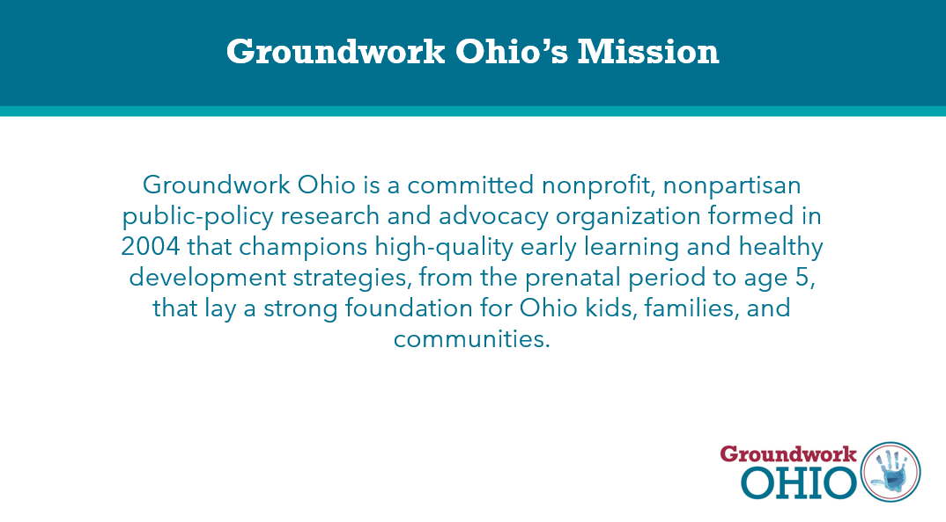

Slide 3
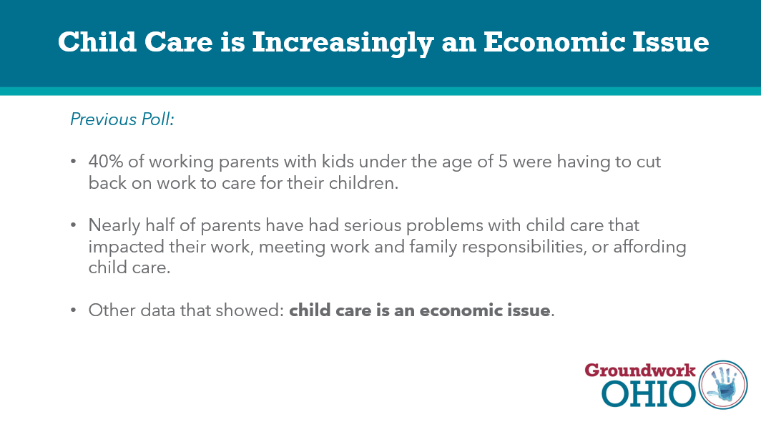

Slide 4
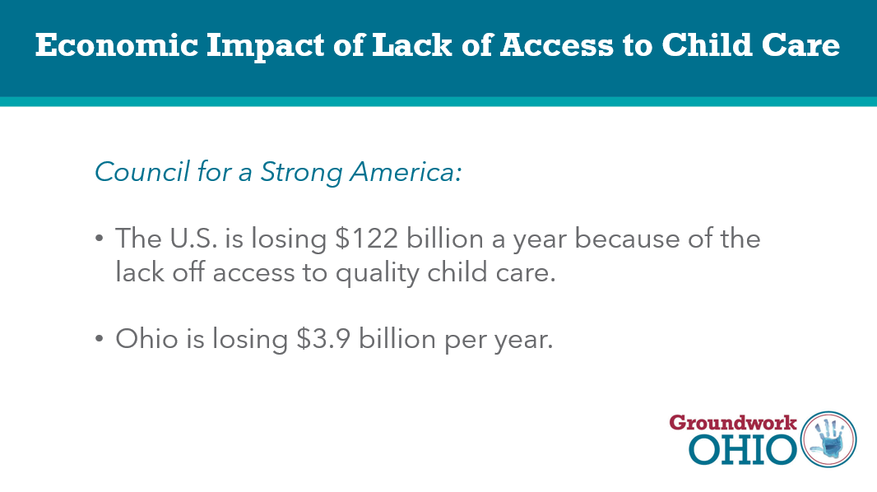

Slide 5




Groundwork Ohio Survey
March 2, 2023
PREPARED BY:
Neil Newhouse, Partner
Jarrett Lewis, Partner

Slide 6

METHODOLOGY
On behalf of Groundwork Ohio, Public Opinion Strategies completed a statewide survey of 800 registered voters and an oversample of 435 parents with children under the age of five in Ohio.
The survey was conducted February 2-13, 2023 and has a margin of error of +3.95% for the registered voter sample and +5.36% for the parent oversample.

Slide 7





Demographic Profile of Full Sample
Ethnicity | % of Sample
White | 81%
People of Color | 19%
African American | 14%
Hispanic | 3%
Party | % of Sample
Republican | 36%
Independent | 30%
Democrat | 30%
Gender | % of Sample
Men | 47%
Women | 53%
Age | % of Sample
18-34 | 18%
35-44 | 22%
45-54 | 16%
55-64 | 19%
65+ | 25%
DMA | % of Sample
Cleveland | 33%
Columbus | 22%
Cincinnati | 16%
Dayton | 11%
Toledo | 8%
Youngstown | 5%
SE Ohio | 6%
Education | % of Sample
Less than College | 55%
College+ | 45%

Slide 8
Demographic Profile of Parents with Children Under Five
Ethnicity | % of Sample
White | 77%
People of Color | 23%
African American | 17%
Hispanic | 3%
Party | % of Sample
Republican | 33%
Independent | 35%
Democrat | 32%
Geography | % of Sample
A city | 29%
A suburban area | 53%
A small town/rural area | 19%
Gender | % of Sample
Men | 45%
Women | 55%
*Mentions of parents throughout this slide deck refer to the above group (unless otherwise noted).

Slide 9
Forty percent of parents interviewed stay home with their child or have a family member who does.
Among Parents
GOP (33%) | IND (35%) | DEM (32%) | White (77%) | Non-White (23%) | Urban (29%) | Sub (53%) | Rural (19%)
43% | 48% | 29% | 41% | 39% | 43% | 38% | 44%
26% | 28% | 34% | 30% | 26% | 32% | 28% | 29%
19% | 15% | 21% | 17% | 24% | 17% | 18% | 22%
9% | 10% | 14% | 11% | 10% | 10% | 13% | 7%
4% | 5% | 8% | 6% | 6% | 4% | 8% | 2%
Spouse/significant other/I stay home full time, no childcare
Part time childcare, my child receives care from a family member, friend, or neighbor
Full time childcare, my child receives care from a family member, friend or neighbor
Full time childcare, my child receives care in a childcare center
Part time childcare, my child receives care in a childcare center
Thinking now a little bit more about your home life. For the majority of the time … do you stay at home with your young children or do you use some type of childcare, or some combination of both? Please select all that apply to you.

Slide 10
Key Findings

Slide 11
KEY FINDINGS
While economic issues dominate Ohio voters’ concerns, early childhood education/child care are strong secondary issues on voters’ minds.

Slide 12
KEY FINDINGS
Ohioans, especially parents, are clearly feeling the impact of the economic slowdown. A significant chunk of voters rate their own financial situation negatively and many have had problems paying their rent/mortgage and credit card bills over the last few months.

Slide 13
KEY FINDINGS
For parents, child care is difficult to access and afford. A majority of parents in the state believe that child care is difficult to find in the state and an overwhelmingly large percentage of all Ohioans (more than 80%) believe that child care is expensive. Further, parents believe that the pandemic has made it harder to both access and afford child care.

Slide 14
KEY FINDINGS
Working parents leave no doubt they are having a difficult time balancing child care and work. Nearly 40% say they have had to miss work, leave early or lose focus because of challenges with child care, with one third of working parents saying they have lost more than five days of work in the past two years because of a lack of child care.
  And, among all Ohio working parents, 4-in-10 have cut back their work hours to care for their children. Putting this into real numbers using Census data, this means over 800,000 working parents have cut back their work hours.

Slide 15
KEY FINDINGS
Ohioans point to the lack of staffing at child care facilities as a problem, with more than two-thirds saying that local child care facilities in their area are having “serious staffing shortages.” Further, a majority of parents say they or someone they know are on the waitlist for child care, and 40% have been on it for longer than six months.

Slide 16
KEY FINDINGS
The linkage between child care and the state’s economy is undeniable – when parents without child care are asked what would they be able to do if they had it, the response was “work more” and “get a job,” while those parents with child care responded “work more” when asked what child care allows them to do. Clearly, parents believe that child care allows them to work more and provide for their families.

Slide 17
KEY FINDINGS
Against this backdrop, there is deep and broad support for increasing funding in the state for child care – fully 80% of registered voters and 87% of parents favor it. Reinforcing that economic tie to child care, fully two-thirds of Ohio moms say they would go back to work if they had access to high-quality and affordable childcare.

Slide 18
Early childhood education/child care issues are strong second-tier concerns.

Slide 19
Ohioans believe controlling inflation and the cost of healthcare are the most important issues right now.
2021 | 2020
* | *
54% | 48%
44% | 37%
48% | 46%
43% | 43%
34% | *
33% | 29%
* | *
% Extremely Important
Getting inflation and cost of living under control
Controlling the cost of health care
Reducing the tax burden on families
Improving the quality of public education
Making sure that children get a strong start in life through quality early childhood education programs
Increasing funding for mental health issues
Helping provide childcare for working parents with young children
Lowering the cost of child care
Now please read some goals that people might have for Ohio right now, and rate how important you personally consider each goal to be – is it extremely important, very important, somewhat important or not that important to you?

Slide 20
Quality early childhood education programs rank well with Ohioans, and better with parents.
% Extremely Important | Total | Parents <5 (N=435) | GOP (36%) | IND (30%) | DEM (30%) | White (81%) | Total Non-White (19%)
Getting inflation and cost of living under control | 68% | 67% | 75% | 70% | 58% | 69% | 65%
Controlling the cost of health care | 53% | 50% | 46% | 47% | 68% | 51% | 61%
Reducing the tax burden on families | 47% | 52% | 46% | 46% | 48% | 43% | 61%
Improving the quality of public education | 43% | 55% | 33% | 44% | 54% | 40% | 60%
Making sure that children get a strong start in life through quality early childhood education programs | 40% | 51% | 29% | 39% | 52% | 35% | 58%
Increasing funding for mental health issues | 39% | 48% | 29% | 39% | 51% | 35% | 58%
Helping provide child care for working parents with young children | 32% | 50% | 18% | 31% | 47% | 27% | 51%
Lowering the cost of child care | 30% | 49% | 20% | 30% | 39% | 26% | 45%
Now please read some goals that people might have for Ohio right now, and rate how important you personally consider each goal to be – is it extremely important, very important, somewhat important or not that important to you?

Slide 21
No question, the economy is impacting Ohioans—especially parents.

Slide 22
Ohioans are divided over the state of their personal financial situation – things have slightly deteriorated for parents since 2021.
2021 Trend:
51% - 49% | 57% - 43%
+9
+5
15%
Poor
15%
Excellent
14%
Poor
10%
Excellent
Currently, how would you rate your own personal or household's financial situation?

Slide 23
More than a quarter of Ohioans are struggling financially—things are bleaker for parents.
2021 Trend:
22% - 75% | 29% - 70% | 32% - 65% | 34% - 64%
In the past few months, have you or anyone living in your household been having serious problems paying your/the rent or mortgage, or not?
In the past few months, have you or anyone living in your household been having serious problems paying credit card bills, loans, or other debt, or not?
-52
-44
-30
-16

Slide 24
Over a third of working parents have faced “serious problems meeting both work and family responsibilities” in the last few months.
2021 Trend:
26% - 70% | 35% - 64%
And, over the past few months, have you or those in your household faced serious problems meeting both work and family responsibilities?
-37
-26

Slide 25
For parents, child care is difficult to access and afford.

Slide 26
A majority of parents believe child care is difficult to find (this has increased by 14-points since 2021). Ohioans OVERWHELMINGLY believe child care is expensive.
2021 Trend:
57% - 43% | 59% - 41% | 20% - 80% | 25% - 75%
Do you generally believe that childcare in your local area is…
Do you believe that childcare in your local area is…
+10
-10
-68
-62

Slide 27
A plurality of all Ohioans believe it has become harder to access child care since COVID-19 started. And a majority of parents believe it has gotten harder to afford and access quality child care in the last year.
And since 2020 and the start of the pandemic, do you think that the availability of high quality and affordable child care has...
In your sense, over the last year, has affording and accessing quality child care become...
-40
-39
-38

Slide 28
Forty-seven percent of Ohioans are worried about being able to put food on the table.
Concerned about being able to put enough food on the table over the next year
Struggling to feed your family
Having issues accessing high quality child care
-6
-18
-42
Do any of the following things apply either to you or to someone you know?

Slide 29
Ohio’s parents are having a more difficult time putting food on the table and accessing high quality child care.
Concerned about being able to put enough food on the table over the next year
Struggling to feed your family
Having issues accessing high quality child care
+16
-2
+12
Do any of the following things apply either to you or to someone you know?

Slide 30
A significant chunk of parents say they have been having serious problems affording child care, and more than one-third say that child care issues have impacted their work.
2021 Trend:
25% - 74% | 37% - 61%
In the past few months, have you or anyone living in your household been having serious problems affording child care, or not?
And, over the past few months, have you or those in your household faced challenges with child care that have caused them to miss work, leave early or lose focus?
-49
-23

Slide 31
Verbatim Summary: Overview
When Ohio parents who say they are experiencing issues accessing high quality child care are asked why this is the case, they most often mention the high cost and the lack of availability.
In your experience, please share a couple ways you are personally having issues accessing high quality child care?

Slide 32
Verbatim Summary: Cost
Many parents describe the cost of high-quality childcare as one of their biggest issues. For example, one Richland father “depends on grandparents to help” because he “can’t afford regular childcare.” And, a female voter in Franklin County says her “job is only fifteen dollars an hour and daycare is too expensive.” For one mother in Cuyahoga County, “the cost of daycare is the same as a paycheck,” so “it isn't worth it to go back to work.” One Lorain County father explains his family “can’t afford it, so [his] wife had to quit her job to stay home.”
In your experience, please share a couple ways you are personally having issues accessing high quality child care?

Slide 33
Verbatim Summary: Availability
For other parents, there simply aren’t good options with available spots in their area. According to a Lucas County mother, “a lot of the type A care in my area is full and there's a waiting list” and she doesn’t “want [her] children in a house setting type of daycare.” And, one Lucas County father explains, “the demand is greater than the services.” For one mother in Jefferson County, daycares are “completely booked” and “you’re on a waitlist for months unless somebody leaves.” One female voter from Seneca County says, “there are not even daycares for all the children needing care” and the centers “have very limited hours.” And one Mahoning County father claims, “it is nearly impossible to find a good place to send [his] kids” because “everywhere is full.”
In your experience, please share a couple ways you are personally having issues accessing high quality child care?

Slide 34
Working parents face special challenges balancing employment with child care.

Slide 35
Problems with child care are having an economic impact – nearly one-third of parents have missed more than five days of work in the last two years because of a lack of child care.
In real numbers: over 800,000 Ohio working parents have cut back hours*
Over the last two years, how many days of work would you estimate you have missed because of a lack of child care?
Over the last couple of months, have you cut back your work hours to care for your children?^
-18
32% More than 5 days
0 days
1-5 days
5-10 days
> 10 days
*2020 US Census Data
^ALL Ohio working parents

Slide 36
More than two-thirds of all Ohioans believe child care centers are experiencing serious staffing shortages.
And, from what you know, are child care centers in your local area having serious staffing shortages?
+38
+46

Slide 37
A majority of Ohio parents indicate they or someone they know are on a waitlist for child care. More than 40% of those on a waitlist have been on it for longer than 6 months.
And, approximately how long is the current waitlist that you are on?* | %
A few weeks or less | 14%
A month to three months | 24%
Three months to 6 months | 15%
< 6 Months | 53%
6 Months+ | 45%
6 months to a year | 19%
One to two years | 14%
More than two years | 12%
And, are you or someone you know currently on a waiting list for child care?
52% Total Yes
*Asked of those who responded “Yes, Self,” N=57 Parents

Slide 38
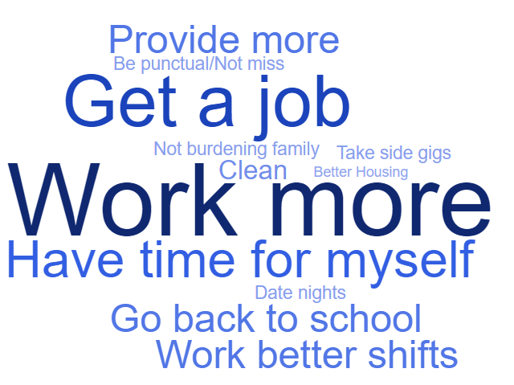
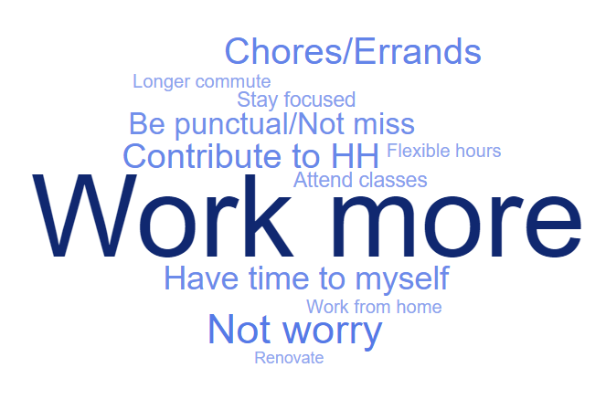
Parents in households where someone is home full time say they would be able to work more if they had access to child care.
If you DID have childcare, what would that allow you to do that you don't do now?*
What does having childcare allow you to do that you wouldn't be able to otherwise?^
*Asked of Sample A Parents who have someone home full time
^Asked of Sample B Parents who use child care

Slide 39
Parents say child care lets them work more reliably, with more regular hours and less stress.
What does having childcare allow you to do that you wouldn't be able to otherwise?^
“The ability to focus and get things done without stress.” –Male, Hamilton County
“Provide for family.” –Male, Mercer County
“Work regular business hours.” –Female, Stark County
“To be there on time.” –Male, Lucas County
“Miss less work and use less PTO. Have time to myself to take care of my needs.” –Female, Hamilton County
“It allows me and my significant other to go to counseling and work on providing a better home experience and family dynamic.” –Female, Stark County
“Work a better paying job and get more hours.” –Female, Lorain County
“Not miss work and attend classes to finish my degree.” –Female, Franklin County
“Work more and even be able to go buy things like grocery easier.” –Female, Hamilton County
“Have a steady reliable place to take my child while I work to provide for our family.” –Female, Butler County
^Asked of Sample B Parents who use child care

Slide 40
More than TWO-THIRDS of Ohio moms say they would go back to work if their child has access to high quality and affordable child care.
% Strongly Agree
Total
I would go back to work if my child had access to quality child care at a reasonable cost.^
2021 Trend
^N=119 Non-Working and Part-Time Moms with Kids Under 5
Now, please read the following statements and indicate whether you strongly agree, somewhat agree, somewhat disagree, or strongly disagree with each statement.

Slide 41
There is overwhelming support for increased funding of child care and early childhood education.

Slide 42
Fully eight-in-ten Ohioans believe the state should increase funding for child care.
Do you believe Ohio should increase funding for child care in order to increase access, affordability and quality?
+60
+74
45%
Definitely
32%
Definitely

Slide 43
Partisans agree—Ohio should increase funding for early child care.
Do you believe Ohio should increase funding for child care in order to increase access, affordability and quality?
Among Total Sample
Among Parents
+38 | +56 | +84 | +64 | +78 | +84
54%
Def.
48%
Def.
47%
Def.
36%
Def.
30%
Def.
19%
Def.

Slide 44
When voters and parents are asked about the current budget for early childhood education…
Sample A
The state currently has a $10 billion education budget and spends 3%, or $300 million, on early childhood education. Do you believe that is about the right amount for the state to be spending on early childhood education, or do you believe it…
Sample B
The state currently has an ongoing education budget and allocates some of it to early childhood education. Do you believe that the amount they spend on early childhood education now is about the right amount for the state to be spending on early childhood education, or do you believe it…

Slide 45
A large majority of voters believe the amount Ohio spends on early childhood education should be increased.
Sample A Wording
Sample B Wording
Combined Results
62%
74%
70%
76%
66%
75%
45%
Definitely
Do you believe that is about the right amount for the state to be spending on early childhood education, or do you believe it...

Slide 46
Support is strongest among parents, Democrats, and voters of color.
% Agree* | Total | Parents Under 5 (N=435) | Men (47%) | Women (53%) | GOP (36%) | IND (30%) | DEM (30%)
Should be significantly increased | 21% | 29% | 20% | 22% | 12% | 17% | 35%
Should be somewhat increased | 45% | 46% | 42% | 47% | 44% | 48% | 42%
Total Increased | 66% | 75% | 62% | 69% | 56% | 65% | 77%
Should be kept the same | 28% | 19% | 31% | 26% | 38% | 25% | 20%
Should be decreased | 6% | 6% | 7% | 5% | 6% | 10% | 3%
% Agree | Total | 18-34 (18%) | 35-44 (22%) | 45-54 (16%) | 55-64 (19%) | 65+ (25%) | White (81%) | Total Non-White (19%)
Should be significantly increased | 21% | 22% | 28% | 22% | 17% | 16% | 18% | 35%
Should be somewhat increased | 45% | 47% | 39% | 46% | 45% | 47% | 45% | 44%
Total Increased | 66% | 69% | 67% | 68% | 62% | 63% | 63% | 79%
Should be kept the same | 28% | 22% | 27% | 27% | 30% | 33% | 32% | 14%
Should be decreased | 6% | 8% | 6% | 5% | 8% | 4% | 6% | 7%
*Combined Results
Do you believe that is about the right amount for the state to be spending on early childhood education, or do you believe it...

Slide 47
Reasons for Supporting Increased Funding

Slide 48
Verbatim Summary: Invest in Future
Many Ohio voters see increasing early childhood education funding as an investment in the state’s future. For example, one female Hamilton County voter explains “it builds the foundation for the rest of their lives” because kids “learn important skills that they will build in for the rest of their lives both academically and socially.” And, a male voter from Marion County believes “early education will help the children develop their social and emotional skills, which will help them a lot in the future.” One Summit County female voter thinks “everyone benefits as a whole,” while a female Stark County voter expresses without early education “some families can’t get ahead, and their children are missing out on the opportunity.” One Franklin County male voter believes early childhood education gives the children “a fighting chance.”
And, in your own words, what are the most important reasons why you (SUPPORT/OPPOSE) increasing early childhood education funding?

Slide 49
Verbatim Summary: Parents Can Work
For other voters, more funding means they may be able to go back to work. According to a Logan County mother, “as parents we need someone to keep our kids, so we can work.” And, a female voter from Mahoning County says childcare lets parents work which “gets them off of benefits and sets them up to succeed.” One female voter in Ashtabula County calls it “senseless to work when all your wages are going to pay childcare expenses.” For one female Butler County voter, childcare funding means “people can go to work and not have to worry about missing work or how they will pay their bills.”
And, in your own words, what are the most important reasons why you (SUPPORT/OPPOSE) increasing early childhood education funding?

Slide 50
Verbatim Summary: Help with Expense
A number of voters think increasing funding would help parents with the cost of daycare. According to a mother in Knox County, she “has children in preschool and it costs a lot even being in the working class.” One Lorain County female voter explains, “child care is eating up what little money many people make.” And, a Lake County mother points out “not everyone can afford to have a stay-at-home parent and children need access to high quality support while parents work.” One Muskingum County female voter says that while “not everyone can afford the best care,” the child “should not be punished.”
And, in your own words, what are the most important reasons why you (SUPPORT/OPPOSE) increasing early childhood education funding?

Slide 51

Neil Newhouse
Partner
Phone: (703) 836-7655
Email: neil@pos.org
Twitter: @KCkid
Jarrett Lewis
Partner
Phone: (703) 836-7655
Email: Jarrett@pos.org
Twitter: @JarrettLewis

